Slide 1
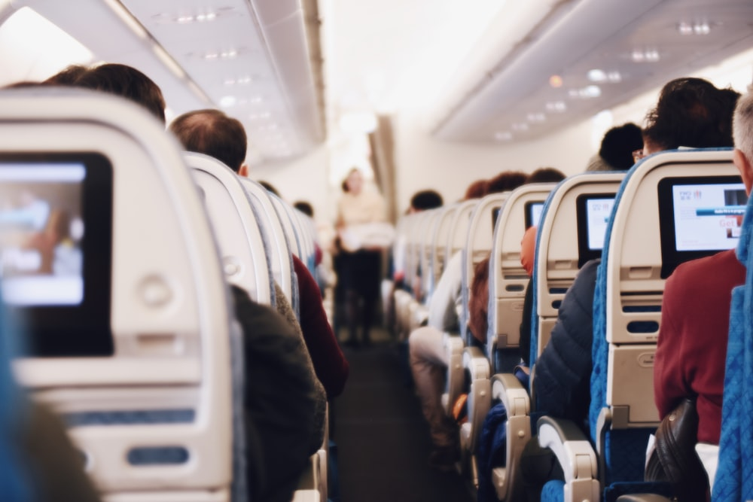
Airline Passenger Referral Prediction
Capstone Project
Capstone Project-III
Supervised Classification
By Sambit Pani

Slide 2
Contents
Problem Statement
Dataset description
Data cleaning
Missing value imputation
EDA
VIF
Anomaly Detection
Model Building
Performance
Explainability
Conclusion

Slide 3
Problem Statement
Data includes airline reviews from 2016 to 2019 for popular airlines around the world with multiple choice and free text questions.
Data is scraped in spring 2019 from Skytrax website.
The main objective is to predict whether passengers will recommend the airline to their family and friends.

Slide 4
Dataset Description
airline: Name of the airline.
overall: Overall point is given to the trip between 1 to 10.
author: Author of the trip
review date: Date of the Review
customer review: Review of the customers in free text format
aircraft: Type of the aircraft
Traveller_type: Type of traveler (e.g. business, couple/family leisure)
cabin: Cabin at the flight(Economic/Premium/Business class etc.)
date flown: Flight date
route: Route of the flight
seat comfort: Rated between 1-5
cabin service: Rated between 1-5
Food_bev: Rated between 1-5
entertainment: Rated between 1-5
Ground_service: Rated between 1-5
value for money: Rated between 1-5
recommended: Binary, target variable
Dataset | Features | Target | Rows
 | 16 | recommended | 131895

Slide 5
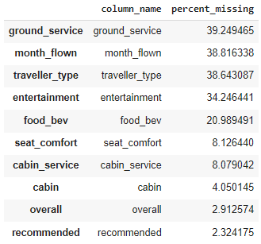
Data cleaning
Alternate rows having NaN values.
4764 duplicate rows.
After that 61183 rows are left.
Extract travel month_flown from date_flown.
Missing Value Imputation
Dropped NaN values from columns seat_comfort, cabin_service, cabin, overall, recommended.
Traveller_type is imputed by ffill to get random values of above row data.
ground_service, month_flown, entertainment, food_bev NaN values will be imputed by median of all columns.
After these data is good to go ahead.

Slide 6
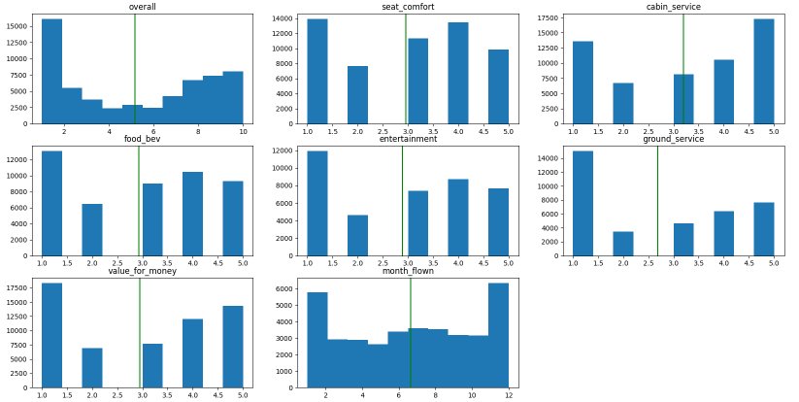
Ratings given by customers
All ratings average is more.
Average ratings in value for money, food_bev, seat_comfort, cabin service and entertainment is more.
Average rating is less for ground_service.

Slide 7
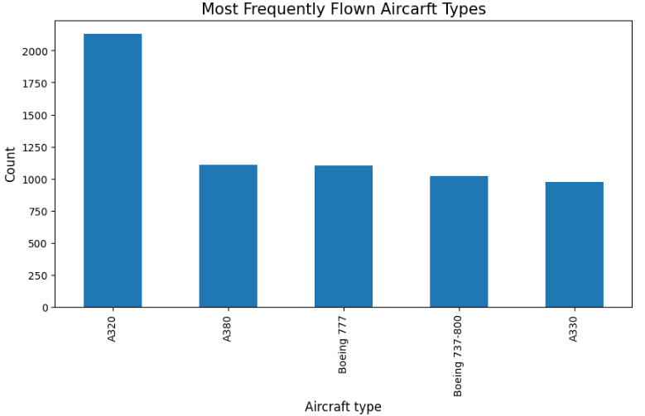
Most flown aircraft type
It has been seen that A320 is the most flown aircraft. So it has to be made comfortable to customers and more focus will be given to this aircraft type.

Slide 8
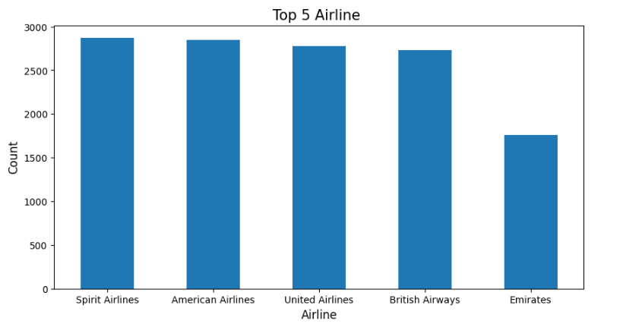
Top 5 Airlines
Most of the data contains Spirit Airlines customer reviews.
Also the top 4 have near to max reviews.

Slide 9
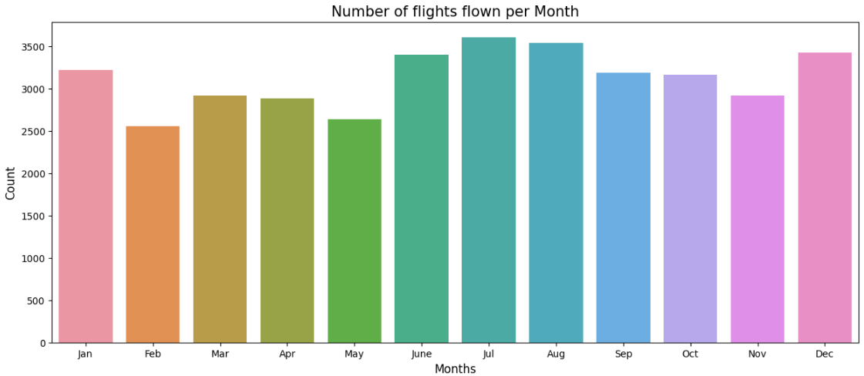
Monthly flight graph
Mostly people travel on December, January and June, July, August.
Because summer and winter vacation is on this time.

Slide 10
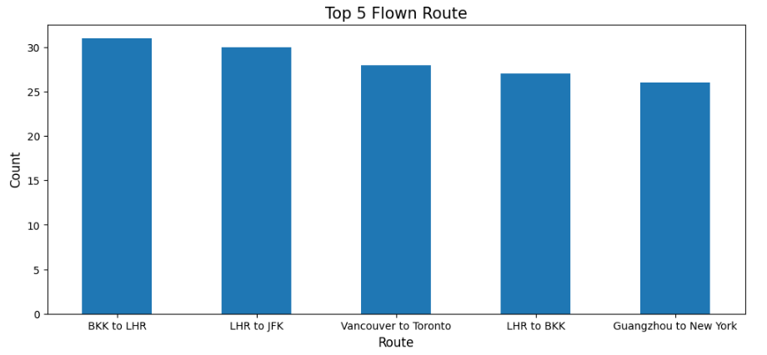
Top 5 Routes
Mostly people go from Bangkok to London and from London to New York.
So these flights to be maintained well and be kept focus on.

Slide 11
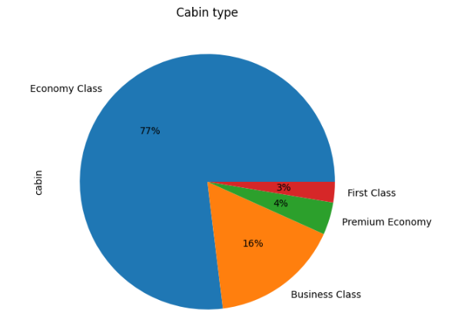
Cabin Type
Cabin type has 4 categories.
Here 77% of the time Economic Class customers are travelling.
This is due to cheaper price in comparison to other classes.

Slide 12
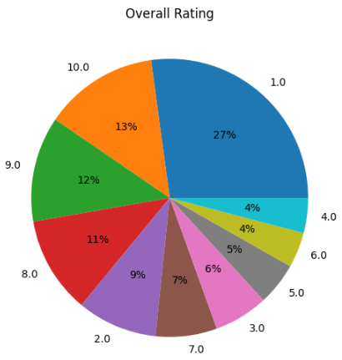
Overall Rating by passengers
Most ratings are above average.
Here 43% of the ratings are 7 and above.
This is a good parameter for predicting the recommendation.

Slide 13
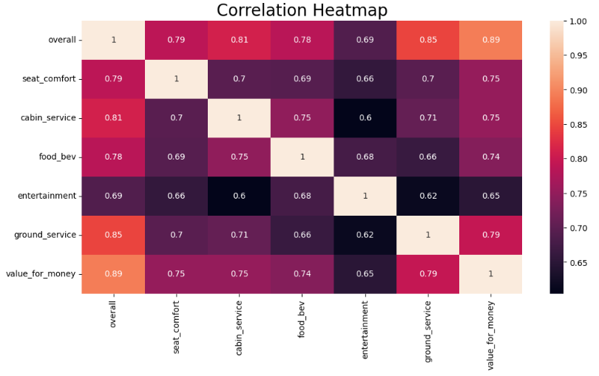
Correlation
Mostly all columns are interlinked with one another.
Two most correlated ones are overall and value for money i.e. 0.89. So one of them should be removed.

Slide 14
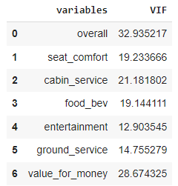
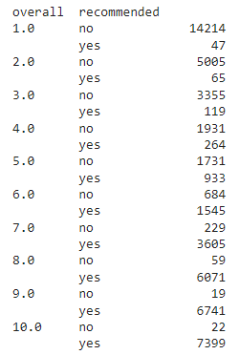
VIF
VIF is more in overall and value for money.
We will remove value for money instead of overall because overall is a collection of all ratings. So we keep it.
Again all VIF are more due to the fact that ratings are interrelated.
Anomaly Detection
It has been observed that overall rating is less but customer has recommended. So it is an anomaly.
Same for overall more rating and recommended is no.
So we need to remove these from the data.
After removing data has 53214 rows.

Slide 15
Dummy and encoding
As traveller_type, cabin are categorical columns. Dummy is required.
Encoding recommended. Yes = 1 and No = 0.
After that there are 16 columns in the data.
Class imbalance
There is 26,920 no and 26,294 yes.
So there is no imbalance in the data
NOW DATA IS READY FOR MODELING

Slide 16
Splitting of Data
Applying train test split on the data with 0.2 split ratio.
After the split shape of rows in train is 42571 and rows in test is 10643.
Train data comprises of 15 features and test data is recommended only.
Model Building
Now we will apply this data to 6 types of algorithms.
And we will choose the best one having good score.

Slide 17
Models Applied
Logistic Regression
Support Vector Machine
Decision Tree
Random Forest
K Nearest Neighbor
Gaussian Naïve Bayes

Slide 18
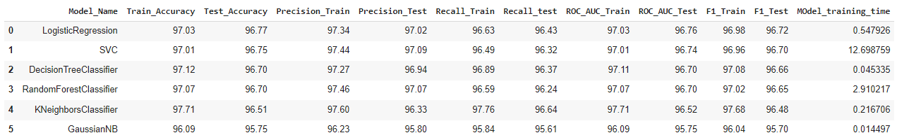
Performance after Hyper-parameter Tune
Logistic Regression the best in-terms of ROC-AUC and F1 score.
So we will choose this model as the best one and check explainability.

Slide 19
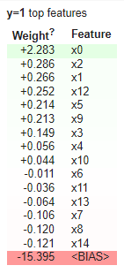
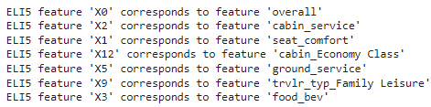
Model Expainability Eli5
For y = yes we have got the feature weights.
The weight is maximum for overall, which is obvious as more is the overall rating there is more chances that traveler will recommend to friends or family members.
Others 5 top weightage features carrying approx. same weight.

Slide 20
Conclusion
From the EDA, we have discovered that A320 is the most commonly used aircraft type and Spirit Airlines is the most flown aircraft by passengers.
77% of passengers choose to fly in economy class as it is the most cheapest.
6 different models fitted by the data and able to generate 95% accuracy in all the models.
So overall rating got identified as the highest weightage. So recommendation will be yes if there is more overall rating.
Cabin Service has second highest weightage. So cabin service has to be improved in order to impress travelers.
Economic class travelers are more prone to recommend their friends and family.
Seat comfort, Ground service and food are carrying approx. equal weights towards recommendation.
The results can be utilized and improve the required key thing to increase customer satisfaction which ultimately leads to revenue generation.

Slide 21
Thank You !

